Slide 1

Auto-Request Assigner Bot
Laiye Automation Challenge July 2021
Team Automators
Team Members:
1.Chaitanya Kulkarni
2.Devneet Mohanty

Slide 2



Problem Statement:
The new generation of customers demand faster responses and better customer service in the retail industry. How can they leverage RPA to help with retailers for delivering good customer service?
For the customer support employees of any organization, it is very repetitive and hectic task to receive chunk of queries from customers in various languages, to translate them and then to categorize them under various categories and assign to respective departments to resolve.
It is very time-consuming and labor-intensive task as employees need to navigate through interfaces of various applications and need the help of language translators or subject matter experts with proper language training before assigning the query to right tech support department.
Can intelligent automation help the customer support employees with ticket assignments?
Lot of query mails from customers
Customer Queries in multiple languages
Employees need to work on multiple applications

Slide 3
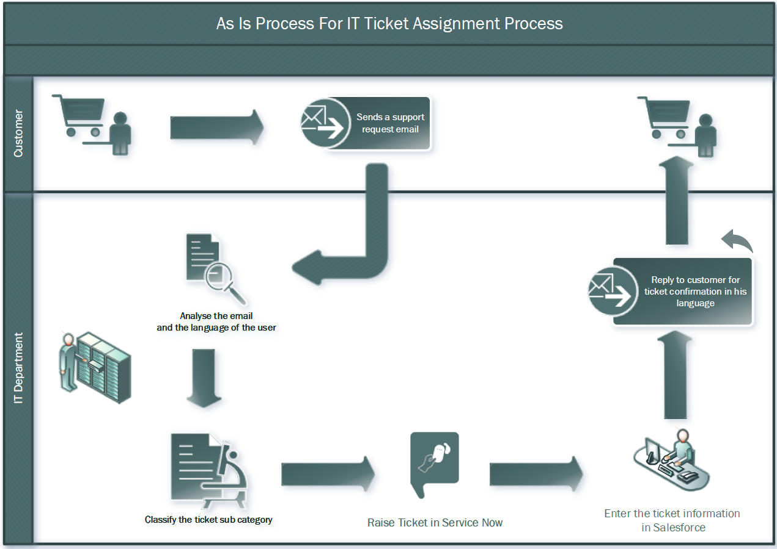
As Is Process:

Slide 4






Solution Overview:
Customer Emails
Customer sends queries in emails
Robot assign incident to respective department and enter details in ServiceNow and Salesforce
Laiye Robot
Laiye Robot read the mails and fetch details
Language Translator Engine
Language Translator engine detects language of mail body and translate to English
Incident Classifier Engine
On basis of provided email body, classifier engine classifies the incident category (For e.g. Software, Hardware or Networking issue)
Phone call to Human
Robot notify to respective associate employee about tickets auto-assigned

Slide 5
Bot in action demo:
Please refer to file ‘Bot In Action Demo.wmv’

Slide 6








Tools Used:

Slide 7
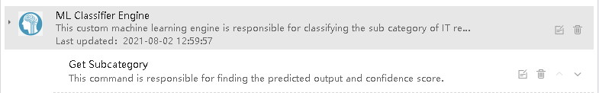
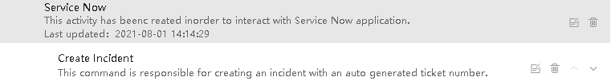
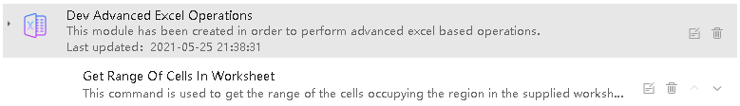
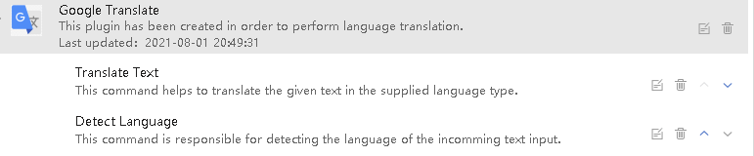
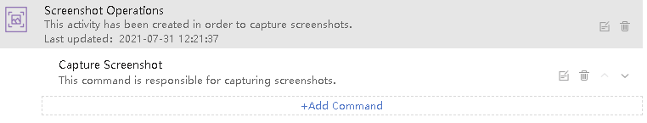
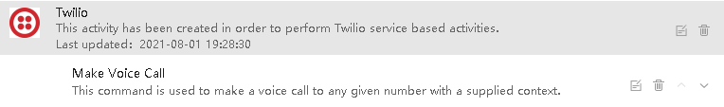
Custom Modules Built:

Slide 8
Thank you!

